Slide 1

Design Principles and Patterns

Slide 2
Agenda
Solid Principles
Design Patterns Introduction
Design Patterns - Creational
Design Patterns - Structural
Design Patterns - Behavioral

Slide 3
Solid Principles
SRP,
OCP,
DIP,
LSP,
ISP

Slide 4
Solid Principles
Design principles encourage us to create more maintainable, understandable, and flexible software.
Consequently, as our applications grow in size, we can reduce their complexity and save ourselves a lot of headaches further down the road!
To create understandable, readable, and testable code that many developers can collaboratively work on."

Slide 5
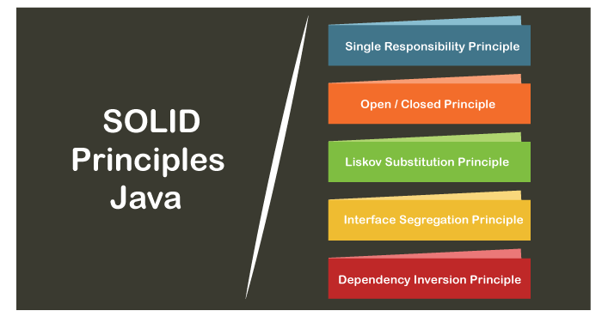

Slide 6
Single Responsibility Principle
The single responsibility principle states that every Java class must perform a single functionality.
Implementation of multiple functionalities in a single class mashup the code and if any modification is required may affect the whole class.
It precise the code and the code can be easily maintained

Slide 7
Student.java
public class Student
{
public void printDetails();
{
//functionality of the method
}
pubic void calculatePercentage();
{
//functionality of the method
}
public void addStudent();
{
//functionality of the method
}
}

Slide 8
Student.java
public class Student
{
public void addStudent();
{
//functionality of the method
} }
PrintStudentDetails.java
public class PrintStudentDetails
{
public void printDetails();
{
//functionality of the method
} }

Slide 9
Percentage.java
public class Percentage
{
public void calculatePercentage();
{
//functionality of the method
}
}

Slide 10
Open-Closed Principle
The application or module entities the methods, functions, variables, etc.
The open-closed principle states that according to new requirements the module should be open for extension but closed for modification.
The extension allows us to implement new functionality to the module.

Slide 11
VehicleInfo.java
public class VehicleInfo
{
public double vehicleNumber(Vehicle vcl)
{
if (vcl instanceof Car)
{
return vcl.getNumber();
if (vcl instanceof Bike)
{
return vcl.getNumber();
}
}

Slide 12
VehicleInfo.java
public class VehicleInfo
{
public double vehicleNumber()
{
//functionality
}
}
public class Car extends VehicleInfo
{
public double vehicleNumber()
{
return this.getValue();
}
public class Car extends Truck
{
public double vehicleNumber()
{
return this.getValue();
}

Slide 13
Liskov Substitution Principle
It applies to inheritance in such a way that the derived classes must be completely substitutable for their base classes.
In other words, if class A is a subtype of class B, then we should be able to replace B with A without interrupting the behavior of the program.
It extends the open-close principle and also focuses on the behavior of a superclass and its subtypes. We should design the classes to preserve the property unless we have a strong reason to do otherwise.

Slide 14
Interface Segregation Principle
The principle states that the larger interfaces split into smaller ones.
Because the implementation classes use only the methods that are required.
We should not force the client to use the methods that they do not want to use.
The goal of the interface segregation principle is similar to the single responsibility principle

Slide 15
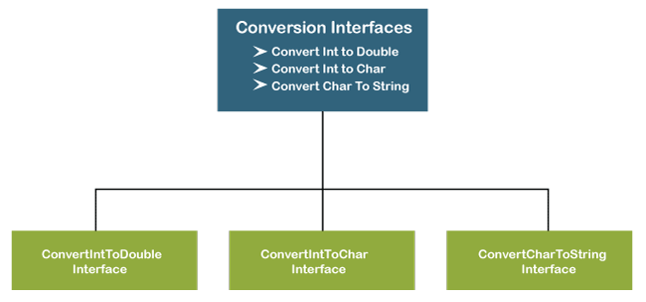

Slide 16
public interface Conversion
{
public void intToDouble();
public void intToChar();
public void charToString();
}
The above interface has three methods. If we want to use only a method intToChar(), we have no choice to implement the single method.
To overcome the problem, the principle allows us to split the interface into three separate ones.

Slide 17
public interface ConvertIntToDouble
{
public void intToDouble();
}
public interface ConvertIntToChar
{
public void intToChar();
}
public interface ConvertCharToString
{
public void charToString();
}

Slide 18
Now we can use only the method that is required. Suppose, we want to convert the integer to double and character to string then, we will use only the methods intToDouble() and charToString().
public class DataTypeConversion implements ConvertIntToDouble, ConvertCharToString
{
public void intToDouble()
{
//conversion logic
}
public void charToString()
{
//conversion logic
}
}

Slide 19
Dependency Inversion Principle
The principle states that we must use abstraction (abstract classes and interfaces) instead of concrete implementations.
High-level modules should not depend on the low-level module but both should depend on the abstraction.
Because the abstraction does not depend on detail but the detail depends on abstraction.
It decouples the software.

Slide 20
public class WindowsMachine
{
//functionality
}
if we have not keyboard and mouse to work on Windows. To solve this problem, we create a constructor of the class and add the instances of the keyboard and monitor.
public class WindowsMachine
{
public final keyboard;
public final monitor;
public WindowsMachine()
{
monitor = new monitor(); //instance of monitor class
keyboard = new keyboard(); //instance of keyboard class
}
}

Slide 21
Now we can work on the Windows machine with the help of a keyboard and mouse. But we still face the problem.
Because we have tightly coupled the three classes together by using the new keyword.
It is hard o test the class windows machine.
To make the code loosely coupled, we decouple the WindowsMachine from the keyboard by using the Keyboard interface and this keyword

Slide 22
Keyboard.java
public interface Keyboard
{
//functionality
}
WindowsMachine.java
public class WindowsMachine
{
private final Keyboard keyboard;
private final Monitor monitor;
public WindowsMachine(Keyboard keyboard, Monitor monitor)
{
this.keyboard = keyboard;
this.monitor = monitor;
}
}

Slide 23
Why should we use SOLID principles?
It reduces the dependencies so that a block of code can be changed without affecting the other code blocks.
The principles intended to make design easier, understandable.
By using the principles, the system is maintainable, testable, scalable, and reusable.
It avoids the bad design of the software

Slide 24
Design Patterns in Java
Design Patterns Introduction
Design Patterns - Creational
Design Patterns - Structural
Design Patterns - Behavioral

Slide 25
Design Patterns Introduction
A design patterns are well-proved solution for solving the specific problem/task.
Problem Given:Suppose you want to create a class for which only a single instance (or object) should be created and that single object can be used by all other classes.
Solution:Singleton design pattern is the best solution of above specific problem. So, every design pattern has some specification or set of rules for solving the problems.

Slide 26
Design patterns are programming language independent strategies for solving the common object-oriented design problems. That means, a design pattern represents an idea, not a particular implementation.
By using the design patterns you can make your code more flexible, reusable and maintainable. It is the most important part because java internally follows design patterns.
To become a professional software developer, you must know at least some popular solutions (i.e. design patterns) to the coding problems.

Slide 27
Advantage of design pattern:
They are reusable in multiple projects.
They provide the solutions that help to define the system architecture.
They capture the software engineering experiences.
They provide transparency to the design of an application.
They are well-proved and testified solutions since they have been built upon the knowledge and experience of expert software developers.
Design patterns don?t guarantee an absolute solution to a problem. They provide clarity to the system architecture and the possibility of building a better system.

Slide 28
Categorization of design patterns:
Basically, design patterns are categorized into two parts:
Core Java (or JSE) Design Patterns.
JEE Design Patterns.

Slide 29
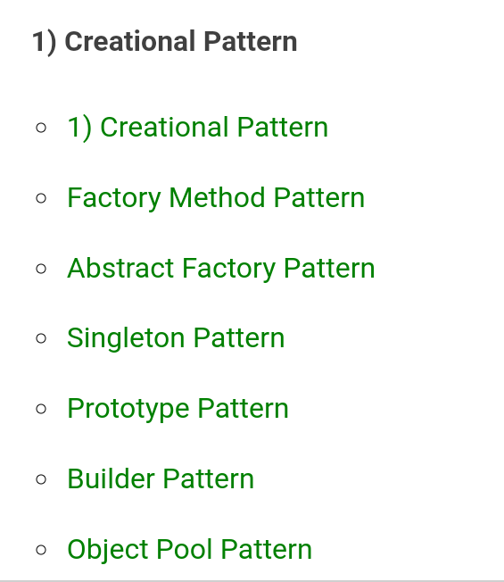
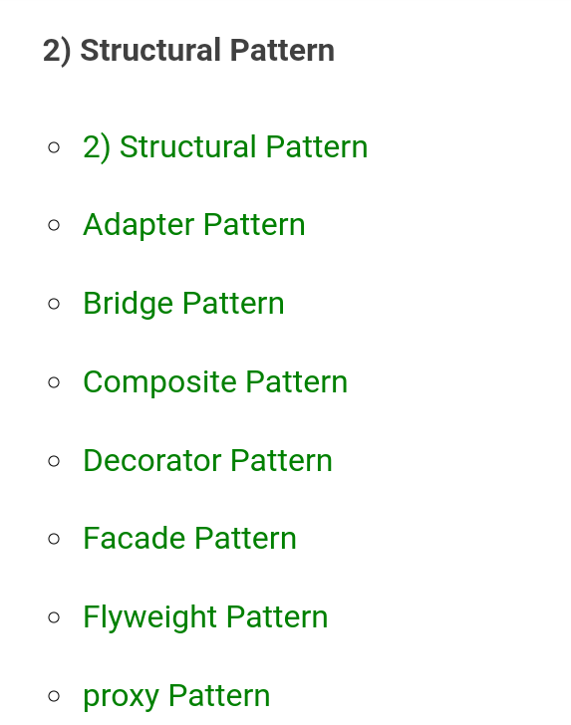

Slide 30
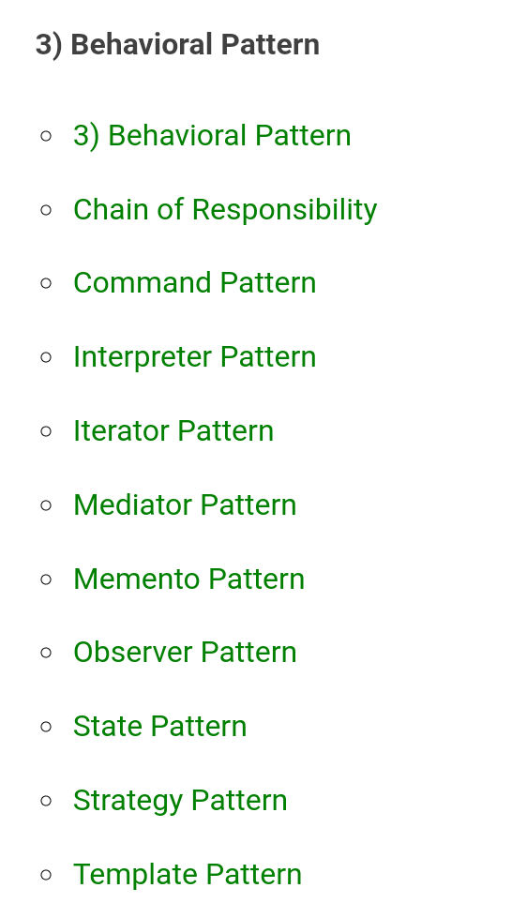

Slide 31

Creational design patterns
Creational design patterns are concerned with the way of creating objects.
These design patterns are used when a decision must be made at the time of instantiation of a class (i.e. creating an object of a class).

Slide 32
we are creating the instance by using the new keyword.
Sometimes, the nature of the object must be changed according to the nature of the program.
In such cases, we must get the help of creational design patterns to provide more general and flexible approach.

Slide 33
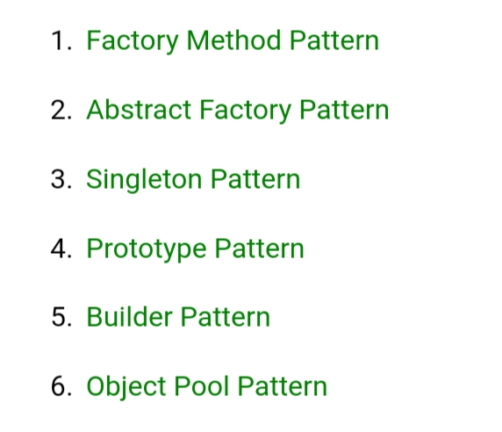
Types of creational design patterns
There are following 6 types of creational design patterns.

Slide 34
Factory Method Pattern
A Factory Pattern or Factory Method Pattern says that just define an interface or abstract class for creating an object but let the subclasses decide which class to instantiate.
In other words, subclasses are responsible to create the instance of the class.
The Factory Method Pattern is also known as Virtual Constructor.

Slide 35
Advantage of Factory Design Pattern
Factory Method Pattern allows the sub-classes to choose the type of objects to create.
It promotes the loose-coupling by eliminating the need to bind application-specific classes into the code.
Usage of Factory Design Pattern:
When a class doesn't know what sub-classes will be required to create
When a class wants that its sub-classes specify the objects to be created.
When the parent classes choose the creation of objects to its sub-classes.

Slide 36
Abstract Factory Pattern
Abstract Factory Pattern says that just define an interface or abstract class for creating families of related (or dependent) objects but without specifying their concrete sub-classes.
That means Abstract Factory lets a class returns a factory of classes.
So, this is the reason that Abstract Factory Pattern is one level higher than the Factory Pattern.
An Abstract Factory Pattern is also known as Kit.

Slide 37
Singleton design pattern in Java
Singleton Pattern says that just"define a class that has only one instance and provides a global point of access to it".
In other words, a class must ensure that only single instance should be created and single object can be used by all other classes.
There are two forms of singleton design pattern
Early Instantiation: creation of instance at load time.
Lazy Instantiation: creation of instance when required.

Slide 38
Prototype Design Pattern
Prototype Pattern says that cloning of an existing object instead of creating new one and can also be customized as per the requirement.
This pattern should be followed, if the cost of creating a new object is expensive and resource intensive.

Slide 39
Builder Design Pattern
Builder Pattern says that "construct a complex object from simple objects using step-by-step approach"
It is mostly used when object can't be created in single step like in the de-serialization of a complex object.

Slide 40
Object Pool Pattern
Object Pool Pattern says that " to reuse the object that are expensive to create".
Basically, an Object pool is a container which contains a specified amount of objects. When an object is taken from the pool, it is not available in the pool until it is put back.
Objects in the pool have a lifecycle: creation, validation and destroy.
A pool helps to manage available resources in a better way. There are many using examples: especially in application servers there are data source pools, thread pools etc.

Slide 41
Structural design patterns
Structural design patterns are concerned with how classes and objects can be composed, to form larger structures.
The structural design patterns simplifies the structure by identifying the relationships.
These patterns focus on, how the classes inherit from each other and how they are composed from other classes.

Slide 42
Types of structural design patterns
There are following 7 types of structural design patterns.
Adapter Pattern:Adapting an interface into another according to client expectation.
Bridge Pattern:Separating abstraction (interface) from implementation.
Composite Pattern:Allowing clients to operate on hierarchy of objects.
Decorator Pattern:Adding functionality to an object dynamically.
Facade Pattern:Providing an interface to a set of interfaces.
Flyweight Pattern:Reusing an object by sharing it.
proxy Pattern:Representing another object.

Slide 43
Behavioral Design Patterns
Behavioral design patterns are concerned with the interaction and responsibility of objects.
In these design patterns,the interaction between the objects should be in such a way that they can easily talk to each other and still should be loosely coupled.
That means the implementation and the client should be loosely coupled in order to avoid hard coding and dependencies.

Slide 44
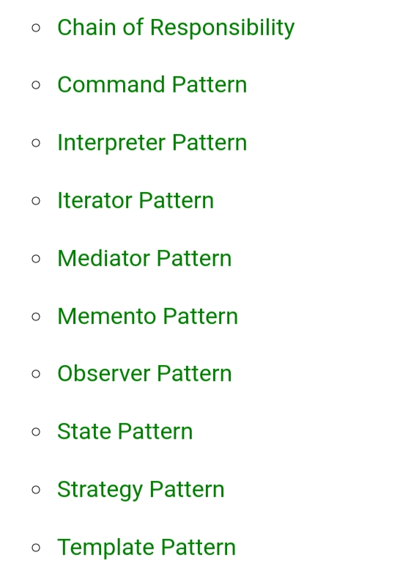
There are 12 types of structural design patterns:

Slide 45


